Slide 1
SPA (Single Page Application)
By : Arun

Slide 2
Agenda
Introduction
History
What is SPA?
What is AJAX?
The Traditional Page Lifecycle vs. the SPA Lifecycle
Where does the “Single Page” Come in?
Object-oriented Design to the Rescue!
Advantages over MPA
Notes:
Sakshi

Slide 3
Introduction
As you all may know, the content you see in your browser is formed from a combination of HTML, JavaScript, Cascading Style Sheets (CSS), and plugins determined by the required content and functionality.
A Single-page application (SPA), also known as a single-page interface (SPI), is a web application or website that fits on a single web page with the goal of providing a more fluid user experience.
Notes:
Sakshi

Slide 4
History
When the web was born it was originally only hypertext documents linked together. Then there was an introduction of a forms tag which started the “web applications” era.
And even though the world is slowly moving from browser-based web applications into the mobile domain, there are still two major design patterns that exist for web applications development – multi page web applications (MPA) and single page web applications (SPA).
MPA is a traditional kind of web application. This means that every time the application needs to display the data or submit data back to server it has to request a new page from the server and then render it in the web browser.
Ten years later the SPA pattern emerged. SPA is essentially an evolution of the MPA+AJAX design pattern, where the only shell page is generated on the server and all UI is rendered by browser JavaScript code.
SPA requests the markup and data separately, and renders pages directly in browser. We can do this because of the new advanced MVVM JavaScript frameworks emerged like AngularJS , React JS and KnockoutJS.
Notes:
Sakshi

Slide 5
What is SPA ?
Single Page Application(SPA) is a web application that fits on a single web page with dynamic actions without refreshing the page.
Single Page Application interactions can be handle without reaching server.
Single Page Application can improve performance in several ways like loading time, using AJAX, easy to navigate pages etc.
End users will be more comfortable with Single Page Application, It is very easy to navigate to different page and filter content.
There are many tricks and technique can use to build awesome Single Page Application.
AngularJS is one of the more popular Single Page Application framework among others.
Notes:
Sakshi

Slide 6
What is AJAX ?
Asynchronous JavaScript and XML(AJAX).
It is not a programming language.
AJAX is the method of exchanging data and updating in website without refreshing the page.
Notes:
Sakshi

Slide 7
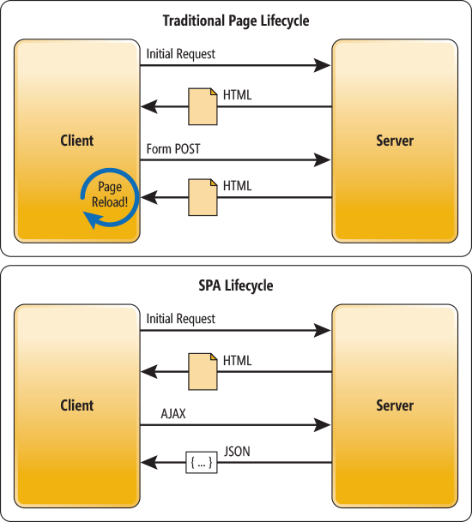
The Traditional Page Lifecycle vs. the SPA Lifecycle
Notes:
Sakshi

Slide 8
Where does the “Single Page” Come in?
The core concept behind a Single Page Application is that the browser only uses one URL.
That means you can bounce around the site, fill out forms, or conduct any normal activity without the location in your browser’s address bar ever changing.
It’s a simple thing from the user’s perspective, but it has big implications for the programmer.
Notes:
Sakshi

Slide 9
Object-oriented Design to the Rescue!
In SPAs, JavaScript is used to create a mini content organization system within the browser.
Now the JavaScript on the page is in charge of the HTML and this makes a developer’s life much easier, with a little help from their favorite framework.
Using object-oriented design principles, rich JavaScript architectures can be created to manage the user’s experience with the content instead of playing catch-up to the constant back and forth hand-off between JavaScript and HTML.
Notes:
Akash

Slide 10
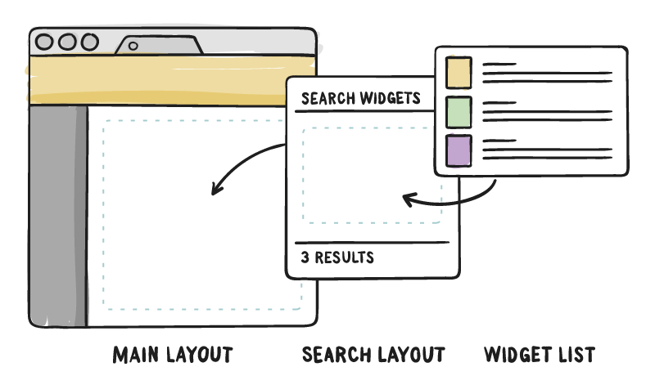
Component based Structure
Notes:
Akash

Slide 11
SPA advantages over MPA
Faster page loading times
Improved user experience because the data is loading in the background from server
No need to write the code to render pages on the server
Decoupling of front-end and back-end development
Simplified mobile development; you can reuse the same backend for web application and native mobile application
Notes:
Akash

Slide 12
Any queries? Open to Q&A

Slide 13
Thank You

